Slide 1

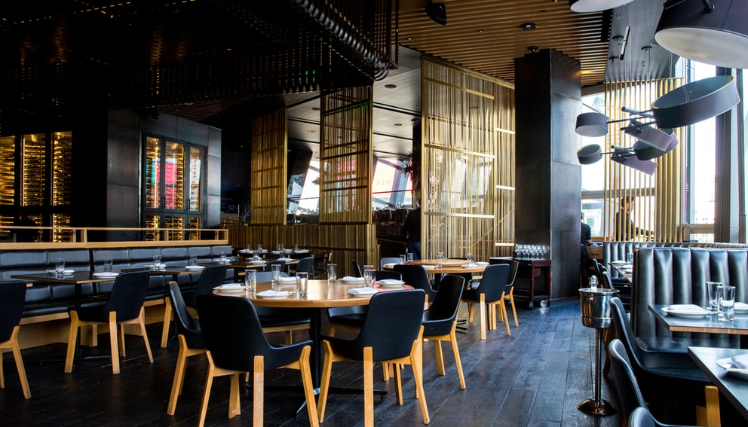

Welcome
GROUP 7
Khizer Humayun, Ebad Ullah Qureshi
Akshat Parmar, Tyler Hong, Shuren Xia
Mai Jianhong, Wang Nianyi, Li Keblin

Slide 2




About IdealMeal IdealMeal is a software that aims to automate restaurants and remove many of the hurdles restaurants are facing today. Main features will be used by
Customers
01
Managers
02
chefs
03

Slide 3
PURPOSE
Designed to improve the collaboration of the employees and increase customer satisfaction.
Making time consuming and everyday task around the restaurant faster.
Increase efficiency and overall income of the restaurant.

Slide 4
Some Features implemented for Demo2
Customer: Login page, order summary, payment, Main page, TakeAway, Reservation.
Manager: Tables, menu, time sheet, Analytics such as employee or item ratings etc.
Chef: Account registration, order queue, order selection, call server, order notification.
NOTE: All the features implemented are in their initial stages, so might not work as expected.

Slide 5
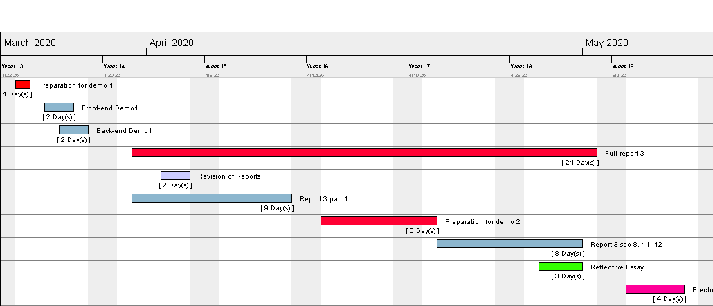
Road map
Future work will include implementing the software as discussed in the report:
By creating detailed and functioning user interfaces.
Implementing and connecting SQL database to our software.
Gather analytical data such as employee/item ratings, efficiency score etc.

